Slide 1
Problem Statement
Identifies the core challenges in loan default prediction and underscores the significance of accurate risk assessment for financial institutions.
- Challenges in Loan Default Prediction
- Importance of Accurate Risk Assessment

Slide 2
Tools Used
Overview of Tools and Technologies
Introduces the tools and technologies employed in the project, including specific Python libraries and data visualization tools, showcasing the technical expertise utilized.
- Python Libraries
Pandas,
NumPy,
Scikit-learn
- Data Visualization Tools
Matplotlib,
Seaborn

Slide 3
Approaches
EDA Approach
- Machine Learning Approach
- Model Selection Criteria
The methodologies adopted, including the EDA approach, machine learning approach, and criteria for selecting models, providing transparency into the project's methodology.

Slide 4
EDA Insights
- Summary of Key Insights from Exploratory Data Analysis
- Visualizations and Patterns Identified
The key insights gleaned from exploratory data analysis, emphasizing the patterns identified and the significance of these findings.

Slide 5
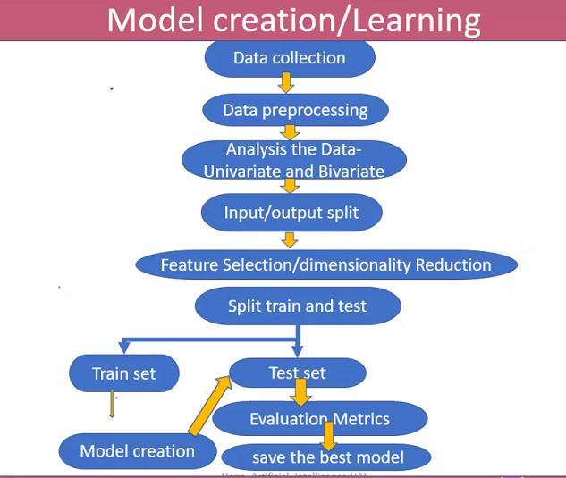

Slide 6
Model Building & Evaluation
- Overview of Model Building Process
Outlines the process of model building, highlights the evaluation metrics employed for assessing model performance, and compares different models used.
- Evaluation Metrics Used
Accuracy,
Precision,
Recall
- Model Performance Comparison

Slide 7
Conclusion/Suggestion
- Findings
- Recommendations for Risk Mitigation Strategies
- Future Scope and Areas for Further Analysis

